Slide 1
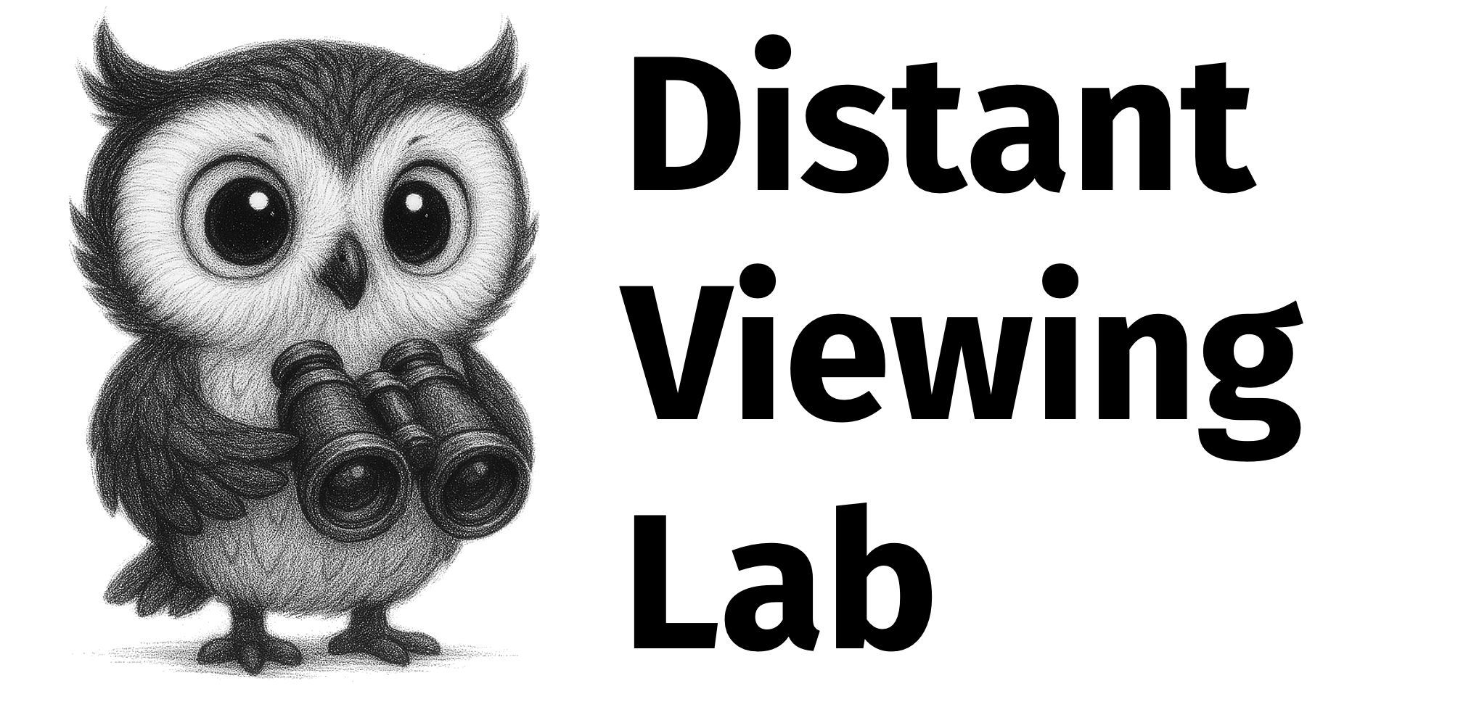
Index of American Design:
Experiments in Distant Viewing
Taylor Arnold + Lauren Tilton
University of Richmond
Distant Viewing Lab
https://distantviewing.org

Slide 2

Outline
Started with a collection of 18,252 digitized drawings from the Index of American Design and associated metadata. All images are publicly available on the NGA website. Metadata came as tabular data dumps from TMS.
In collaboration with the NGA team, we aimed to: (1) apply various multimodal AI techniques to the data and (2) produce a prototype of a public website illustrating ways that the output of these models can be integrated into a public digital platform to increase access and discovery of the collection.
https://distantviewing.org

Slide 3
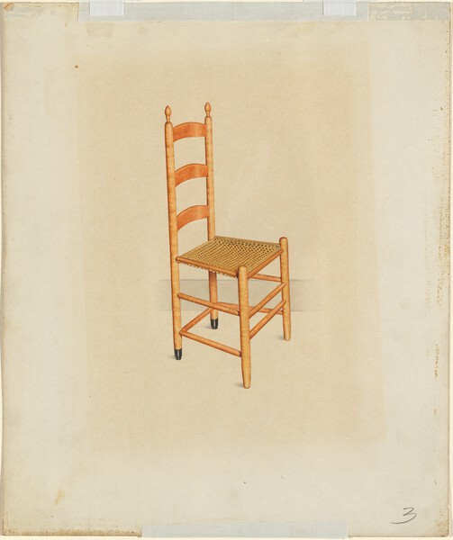
Algorithm #1: Text and Image Embedding with SigLIP
The first technique we used was to run the SigLIP model over every image in the collection. This model can embed both text and images, with the goal of placing images close to their captions.
782-Dimensional Embedding Space
John W. Kelleher, Shaker Tilting Chair (c. 1937). ID: 29240
"drawing of a wooden chair"
https://distantviewing.org

Slide 4
Algorithm #2: Automatic Captions with an MMLLM
Our second technique uses a Multi-modal LLM model (gpt-4.1-2025-04-14) to generate automatic captions for each image. These usually provide useful information but are far from perfect.
The drawing depicts a single wooden chair positioned at an angle, with its back facing slightly to the left side of the image. The chair features a ladder-back design with three horizontal slats between two vertical posts, both reaching above the slats and capped with pointed finials. The seat is square and appears to be woven from light-colored material. The wood of the chair has a warm, orange-brown tone. Each of the four legs is cylindrical and joined by double horizontal stretchers on each side. The two front legs remain unadorned, while the bottom parts of the back legs have black covers or tips. The chair is centered on a beige background with a subtle gradient effect around the chair, bordered by a simple rectangular frame. There is a faint number "3" written in the bottom right corner, and tape is visible at the top and bottom edges securing the drawing.
"Provide a detailed plain-text description of the objects in this drawing as a single paragraph. Include information about the color and composition of the drawing. Do not give any subjective summary."
John W. Kelleher, Shaker Tilting Chair (c. 1937). ID: 29240
https://distantviewing.org

Slide 5
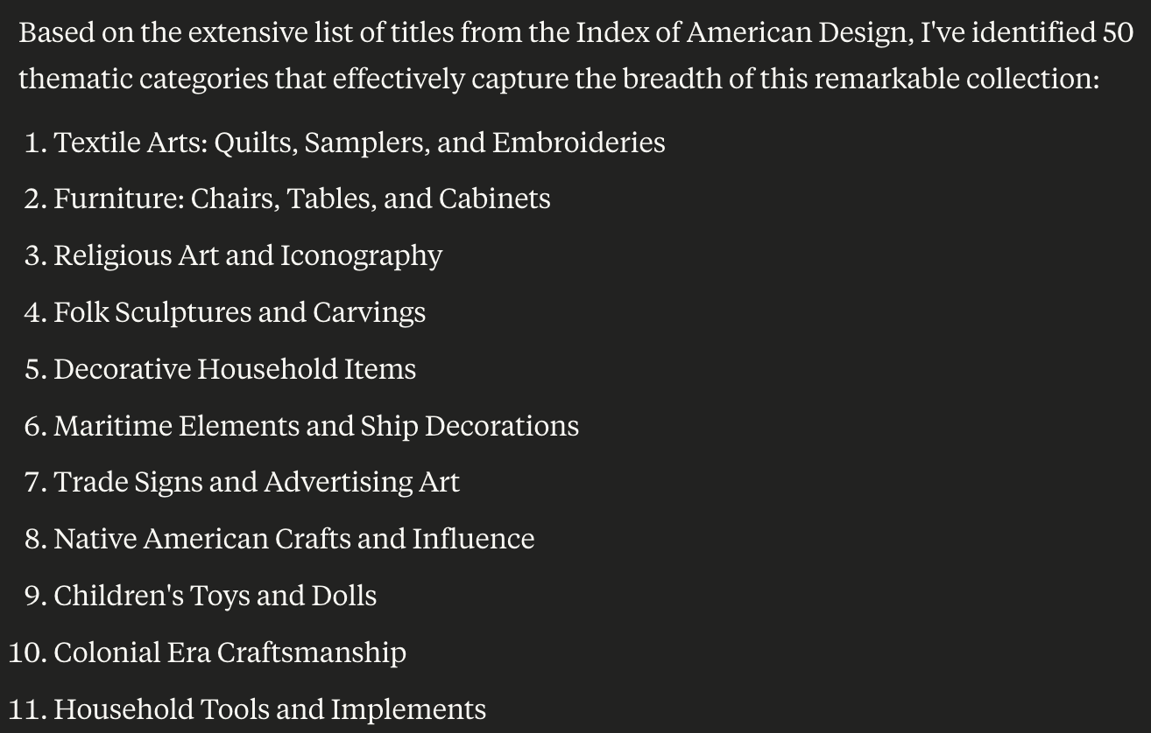
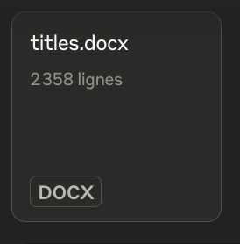
Algorithm #3: Themes with LLM
Our third technique starts with a text file with the captions generated by the MMLLM, ingests them into another LLM (Claude 3.7), and generates a list of 50 themes found across the descriptions.
"This document contains all the titles of art works in a collection called the "Index of American Design". Can you suggest a set of 50 themes that capture all the elements in the collection?"
https://distantviewing.org

Slide 6
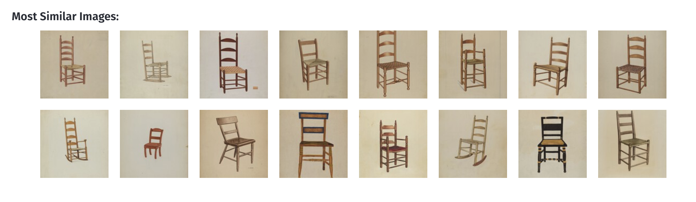
Algorithm #4: Aggregating Output
With these multimodal outputs collected, we (1) use the SigLIP model to assign each image to the cluster who title has an embedding closest to it, (2) use TF-IDF from the captions to generate keywords for each image, and (3) use the SigLIP embeddings to generate nearest neighbors for each image.
Cluster #02 — Furniture: Chairs, Tables, and Cabinets
Keywords: chair – slat – back – leg – reach – secure – gradient – stretcher – join – remain
https://distantviewing.org

Slide 7
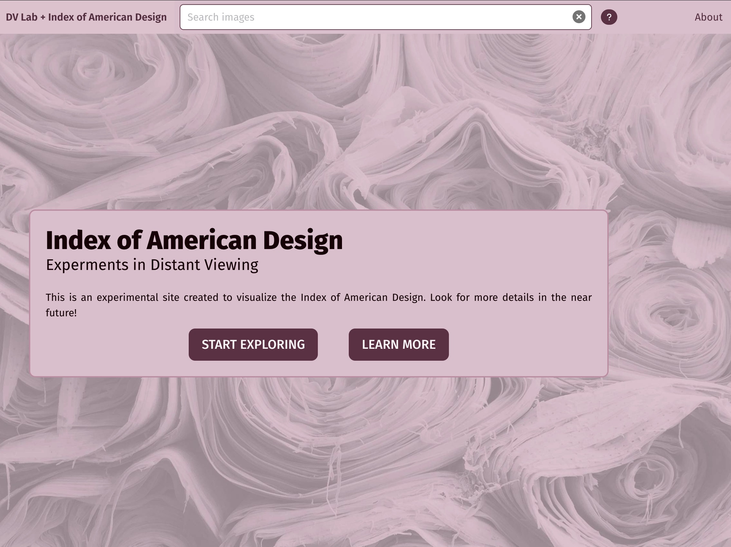
Prototype Site
distant-viewing.github.io/iad-demo/
We have built a public prototype illustrating how these features can be integrated into a search and discovery interface.
The site allows us to (1) easily explore the possibilities of the methods and (2) see some possibilities for language surrounding the use of AI methods in public archival projects.
The backend infrastructure is designed to be very minimal and is likely not very useful for longer-term projects.
https://distantviewing.org

Slide 8
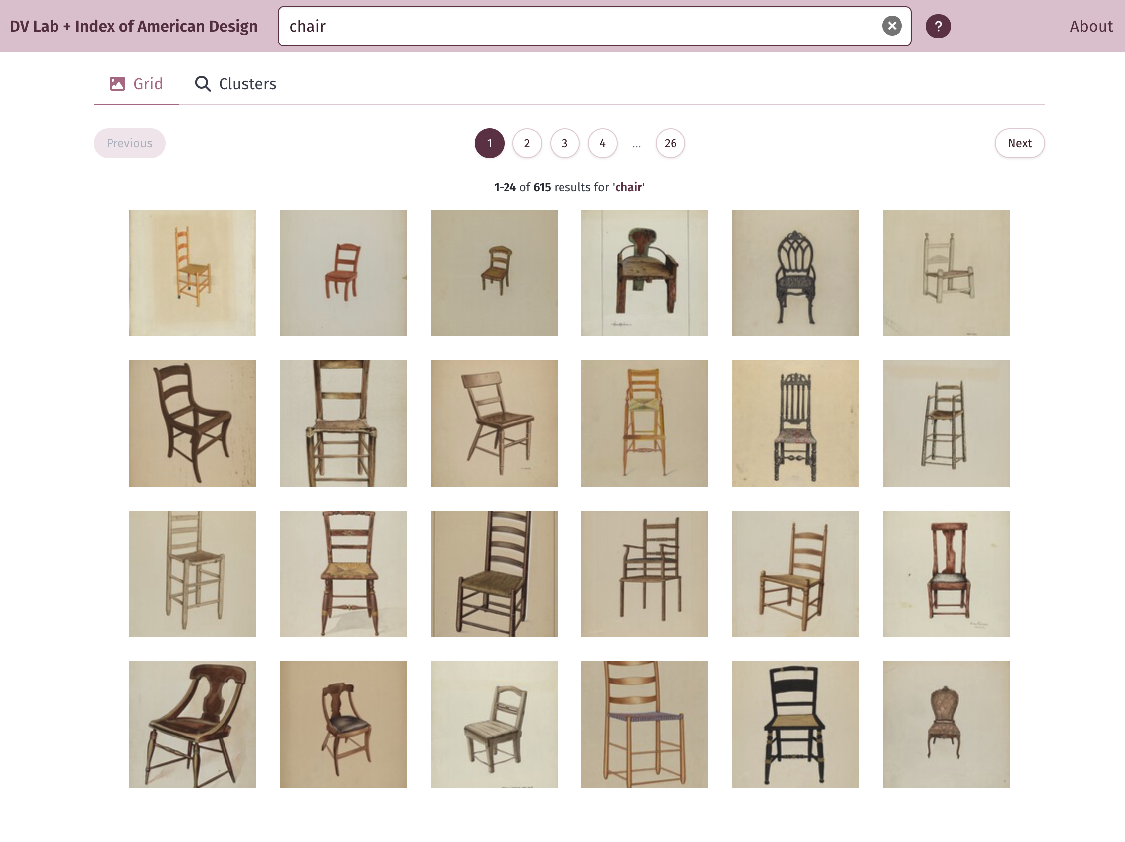
Two-Stage Search Interface
The site allows for full-text search of the existing metadata and auto-generated captions.
After the captions are used to filter the collection the SigLIP model is used. We embed the search term (live, in the browser), and sort the results from the most similar to the caption "chair" to the least similar.
Here are the 24 most chair-like images from the total set of 615 that contain "chair" some where in their title or caption.
https://distantviewing.org

Slide 9
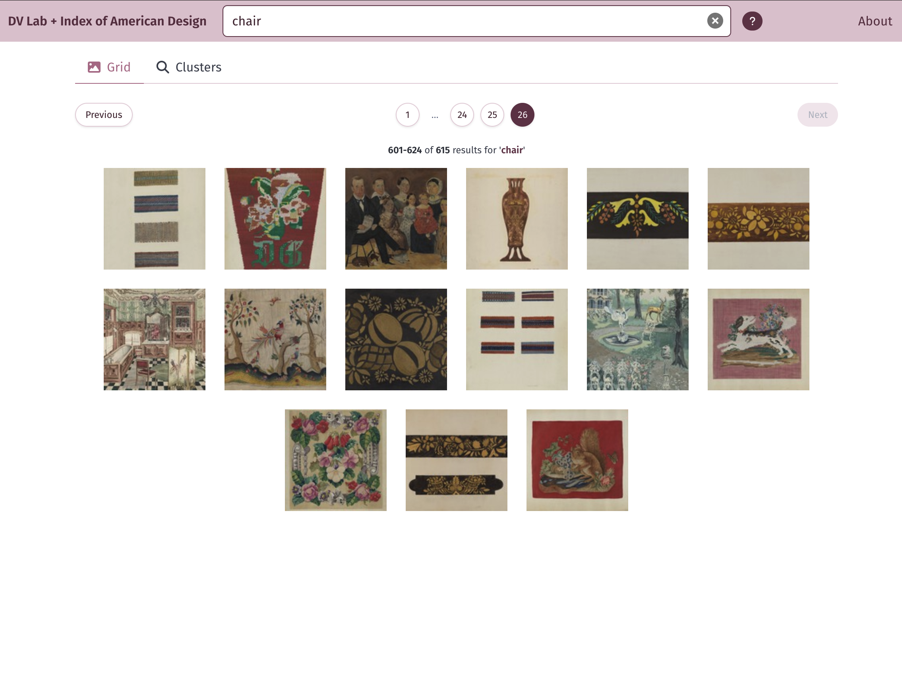
Two-Stage Search Interface
To understand better what is going on, we can scroll to the last set of images that are contained in the filter but the least close to the phrase "chair".
Almost all of these have chair in the title (many are "chair covers") but do not seem to have an actual chair in the image.
https://distantviewing.org

Slide 10
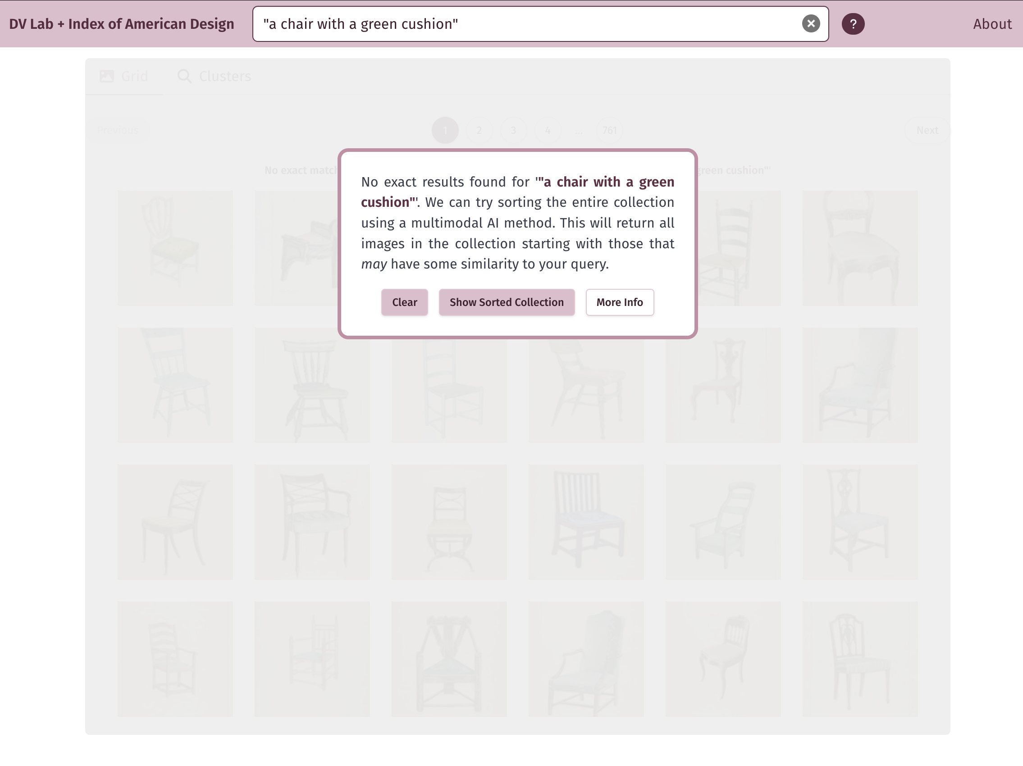
Two-Stage Search Interface
Consider now searching for something very specific, for example "a chair with a green cushion". None of the captions contain this exact phrase, and the message warns the user about this.
However, we can still try to find images that are most similar to this phrase by using the SigLIP-base sort on the entire collection.
After user testing, we decided to make visitors to the site explicitly indicate that they are okay moving forward with this.
https://distantviewing.org

Slide 11
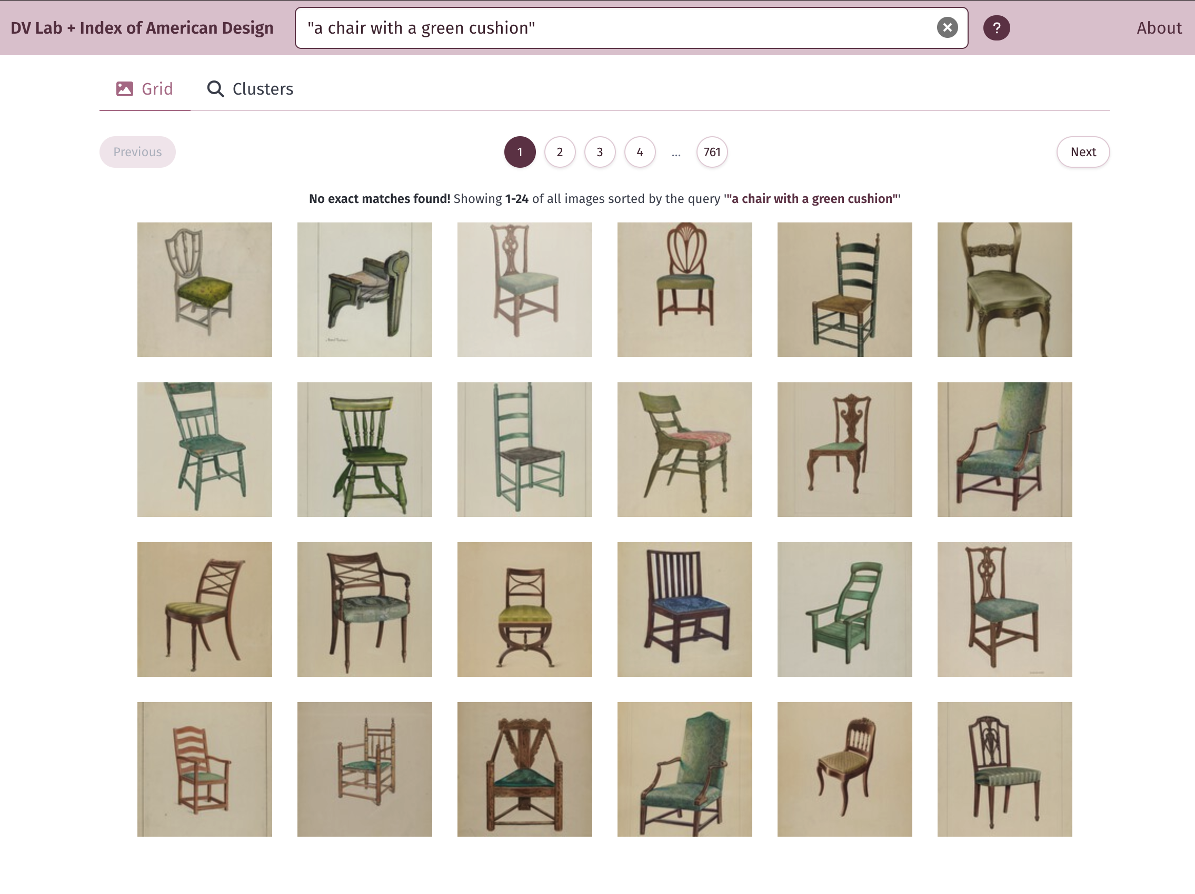
Two-Stage Search Interface
The output contains all 18,252 records sorted by the caption. In this case, we see that there are in fact many chairs with a green cushion.
This is great for finding very specific phrases in a corpus but does not work well for filtering. There is no good way to figure out how many of the top answers are in fact chairs with green cushions (if any are).
https://distantviewing.org

Slide 12
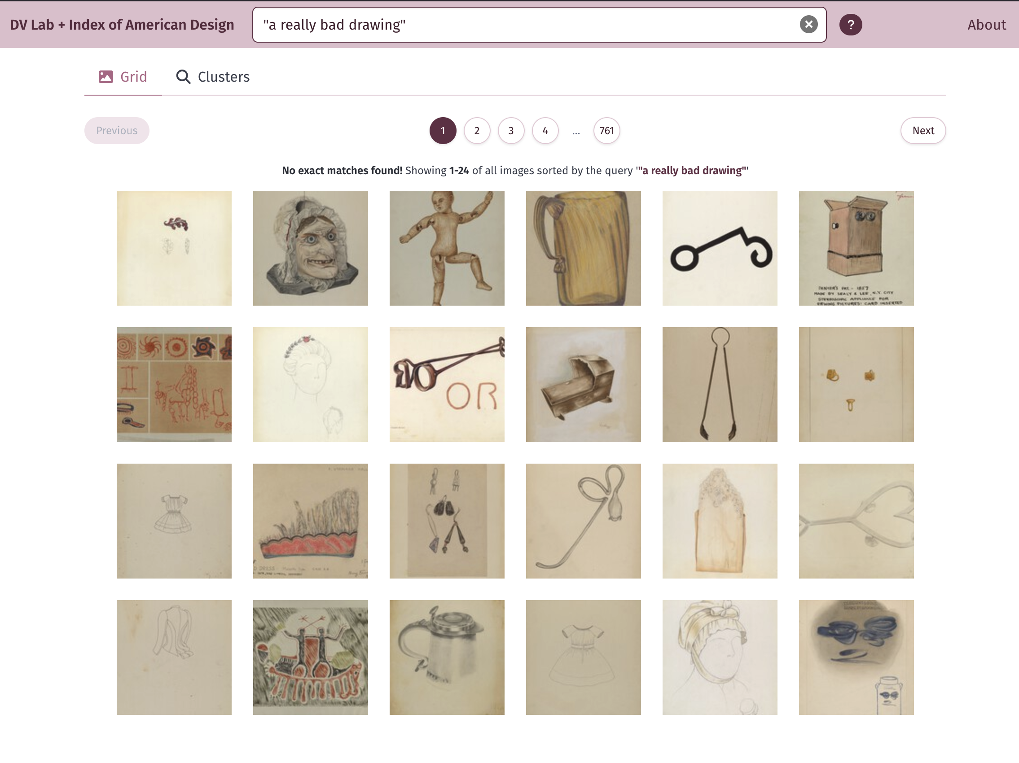
Two-Stage Search Interface
One specific example of the issue is that users can search for any phrase and the results will always return the entire collection.
For example, there might be issues with searches such as "a really bad drawing". Something will show up. Will this get read as someone saying these are bad drawings?
https://distantviewing.org

Slide 13
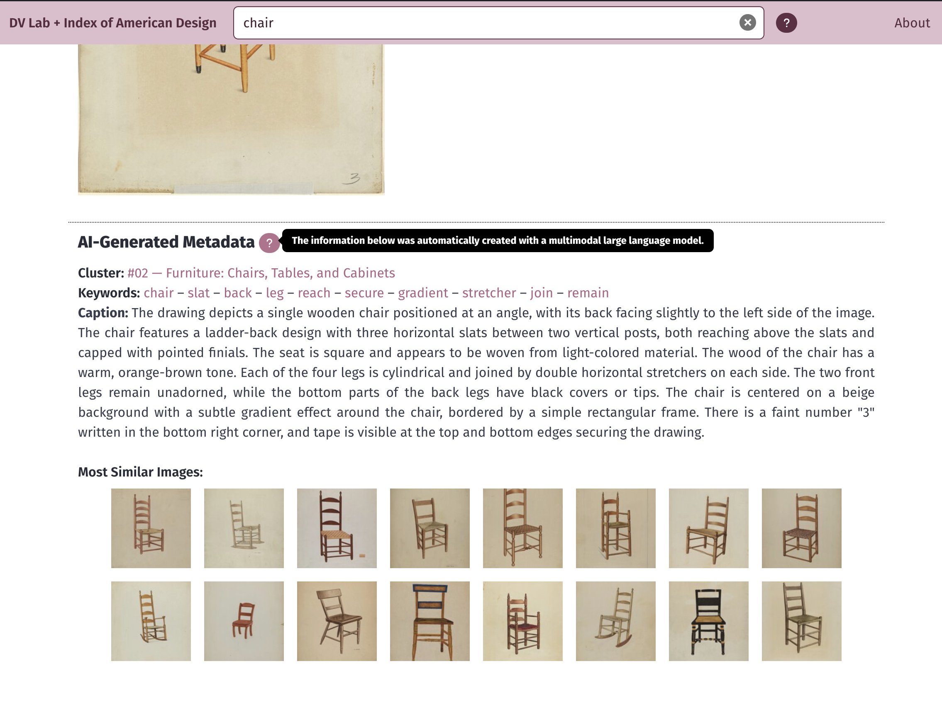
AI Generated Data: Display Techniques
Clicking on the image shows a specific page for each record. The archival data is shown at the top and the AI-generated data is shown at the bottom. These are clearly differentiated, and references provide more information.
The caption is likely not that useful for a production site (we can just view the image itself; very little is gained in most cases). But it is useful for understanding how the search functions work.
The keywords can be useful to suggest interesting search terms.
https://distantviewing.org

Slide 14
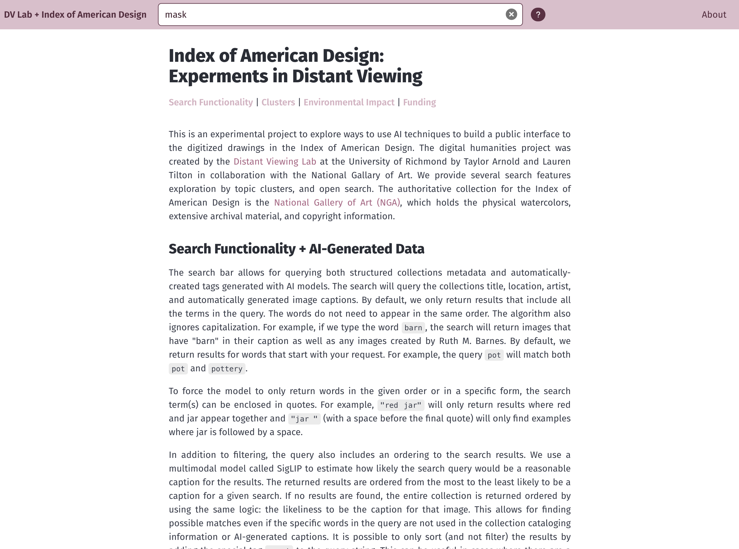
AI Generated Data: Display Techniques
Here is an example of the about page describing the AI methods used in the site and explaining the specific methods used in the search algorithm.
https://distantviewing.org

Slide 15
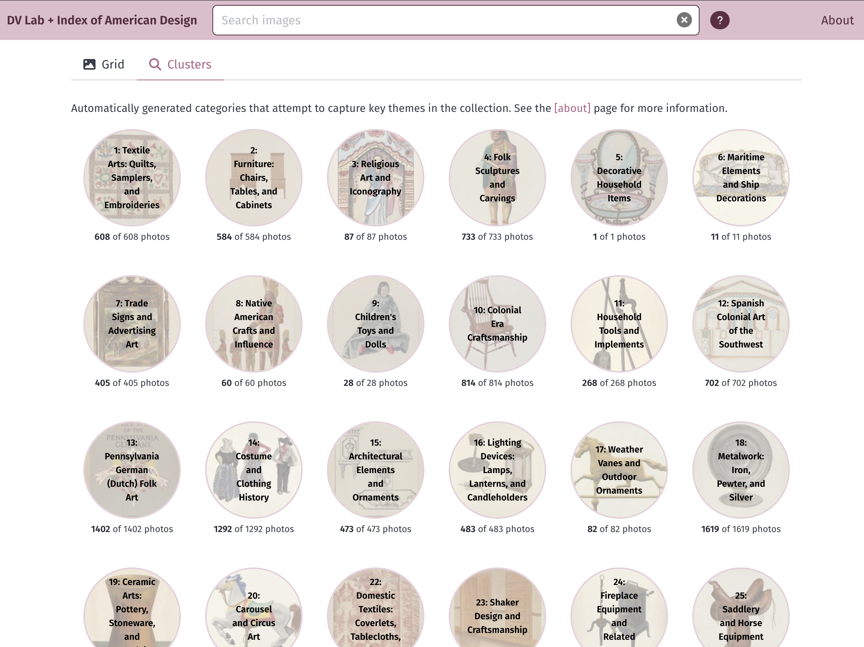
AI Generated Data: Clusters
The site supports various forms of generous interfaces, such as a visualization of the clusters. Here, we use SigLIP to automatically find example images that appear to closely represent the cluster names.
https://distantviewing.org

Slide 16
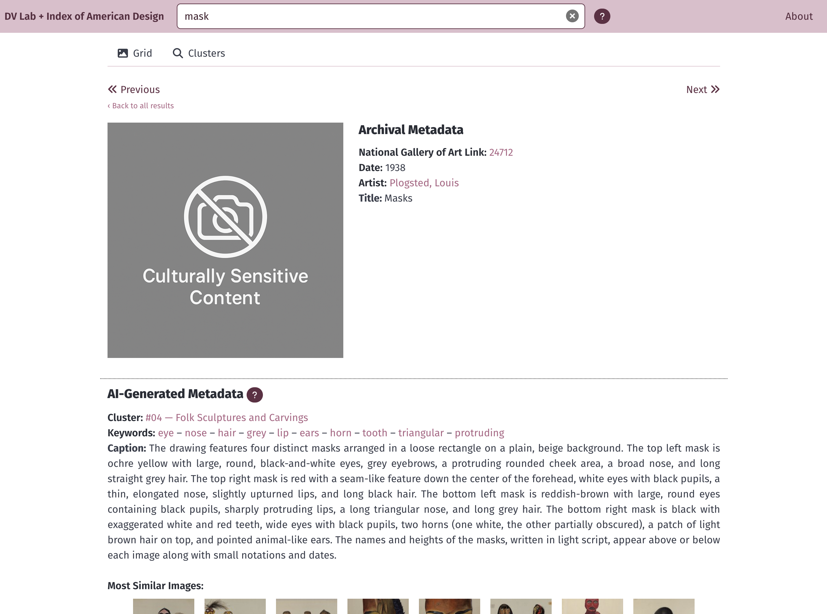
AI Generated Data: Captions as an Image Replacement
After building the prototype, we learned that one of the images from the collection was removed the NGA site due to its culturally sensitive content. The metadata is still available.
We replaced the image with a placeholder but have kept the automatically generated caption. Replacing the image with an AI-generated caption is one possible way to balance preserving the historical record with the need of being culturally sensitive to what is displayed on a public website.
https://distantviewing.org

